Slide 1



Slide 2
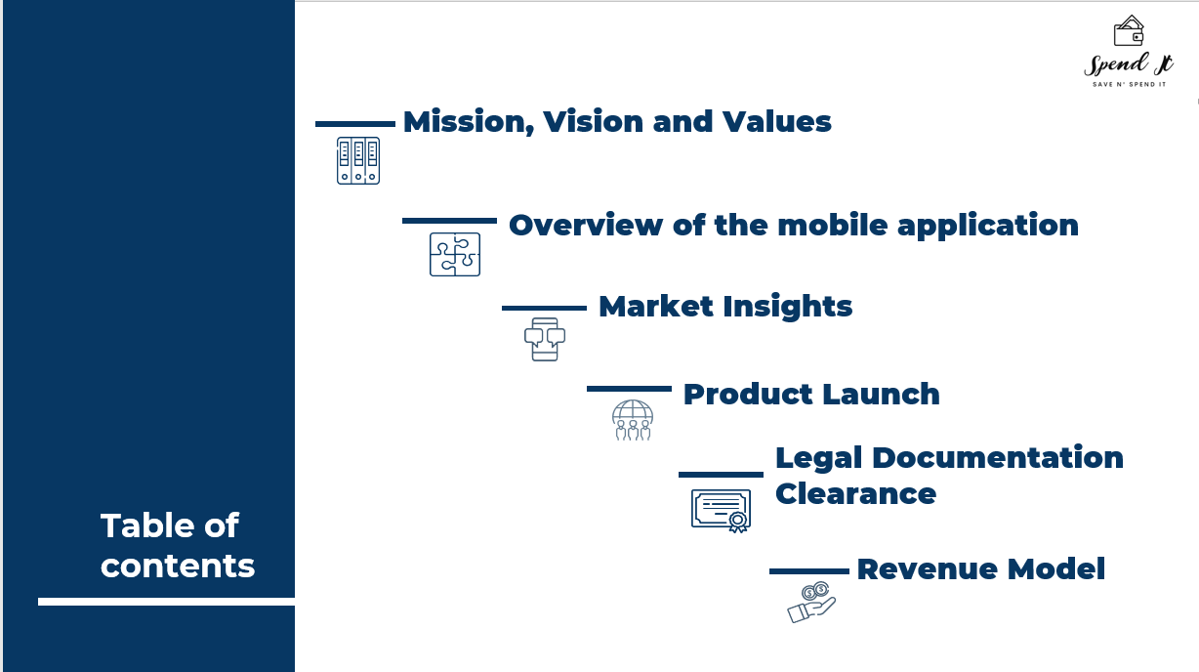

Slide 3




Company Statement
Mission
Vision
To drive India towards a cashless economy
To create a brand image
To penetrate every market segment in the world.
Reliable provider in the payment industry
Values
Performance excellence
Teamwork & Integrity
Democracy on the web works.
Focus on the user and all else will follow.

Slide 4


 | In-app features | Spend-it
Funding methods | Bank account using UPI Stored value wallet Debit, credit card
Payment features | Send money Request money QR code scanner
Bill payments | Recharge prepaid numbers Pay utility bills Pay insurance premiums, EMI or credit card bills
E-commerce, travel | Purchase of groceries/merchandise Flight & hotel bookings Book Uber/Ola car rides
Other | Chat with Contacts Check bank balance Plan Budget ( unique feature)
What are the features of this app?

Slide 5


Unique Features
1. Target market is from the age 14+
2. Two types of setups:
(i) 14-18 yrs, (ii) 18+.
3. Budgeting Rule
50% needs
30% wants
20% savings
4. Giving rewards if the savings are more than 25%.

Slide 6

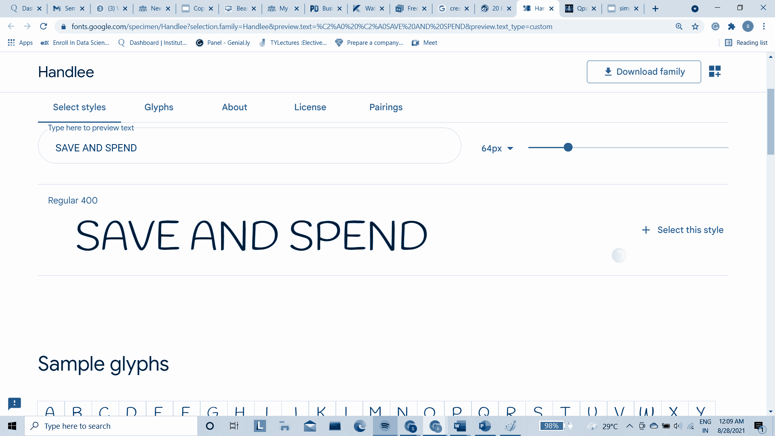
Market Insights

Slide 7
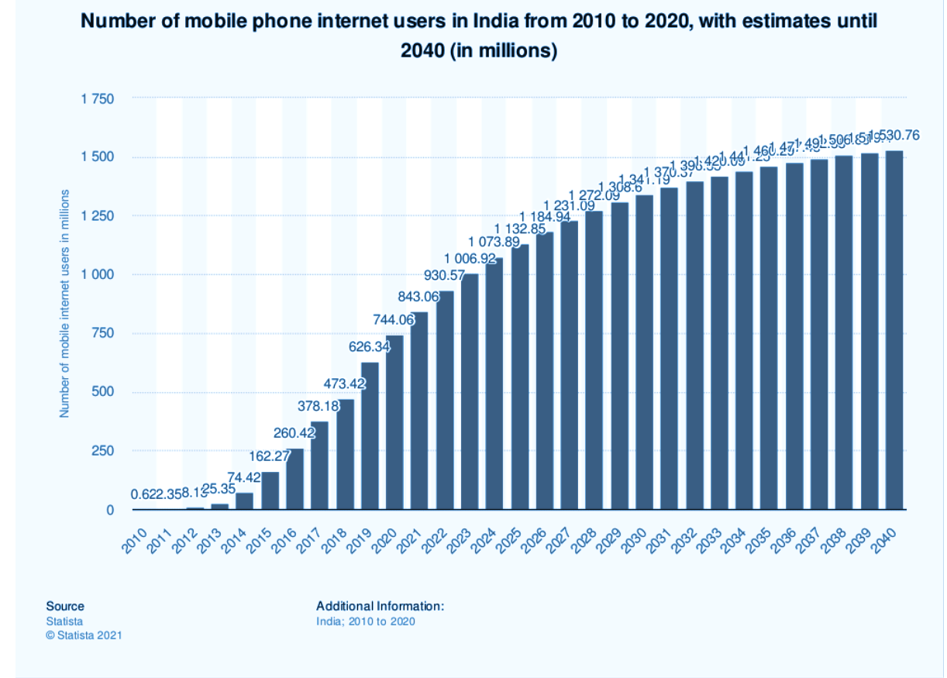
Number of mobile phone internet users in India from 2010 to 2020,
with estimates until 2040 (in million)
Jill can do this

Slide 8
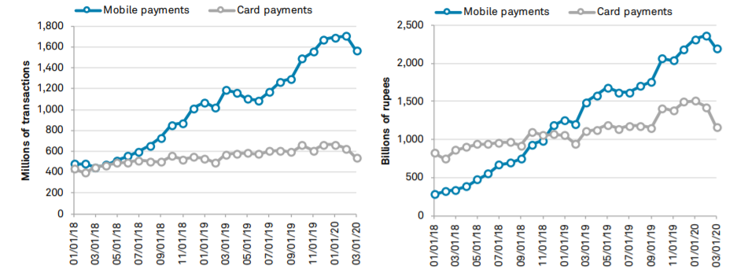
Mobile Payments growing faster than cards in India

Slide 9
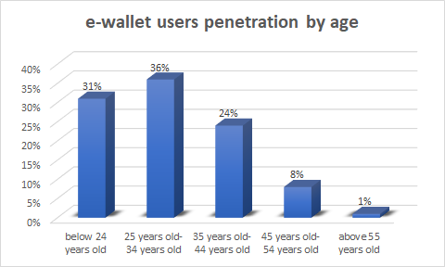
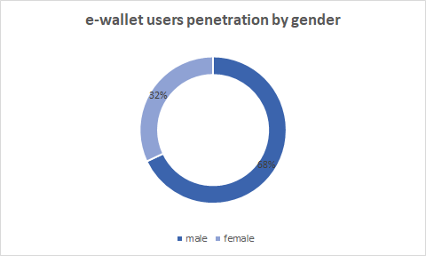

Slide 10


PRODUCT LAUNCH
1. Target Market
2. Development of the App
3. Marketing of the product.
4. Launching of the App

Slide 11

Data Protection
Rules
And
Regulations
Customer Protection
RBI licensing
The Payment and Settlement System

Slide 12






How do we scale-up our business?
Youtube ads
Television Ads
Marketing Strategy
Social media
Influencer
News app / App store optimisation
Billboards & posters

Slide 13
Revenue Model

Slide 14
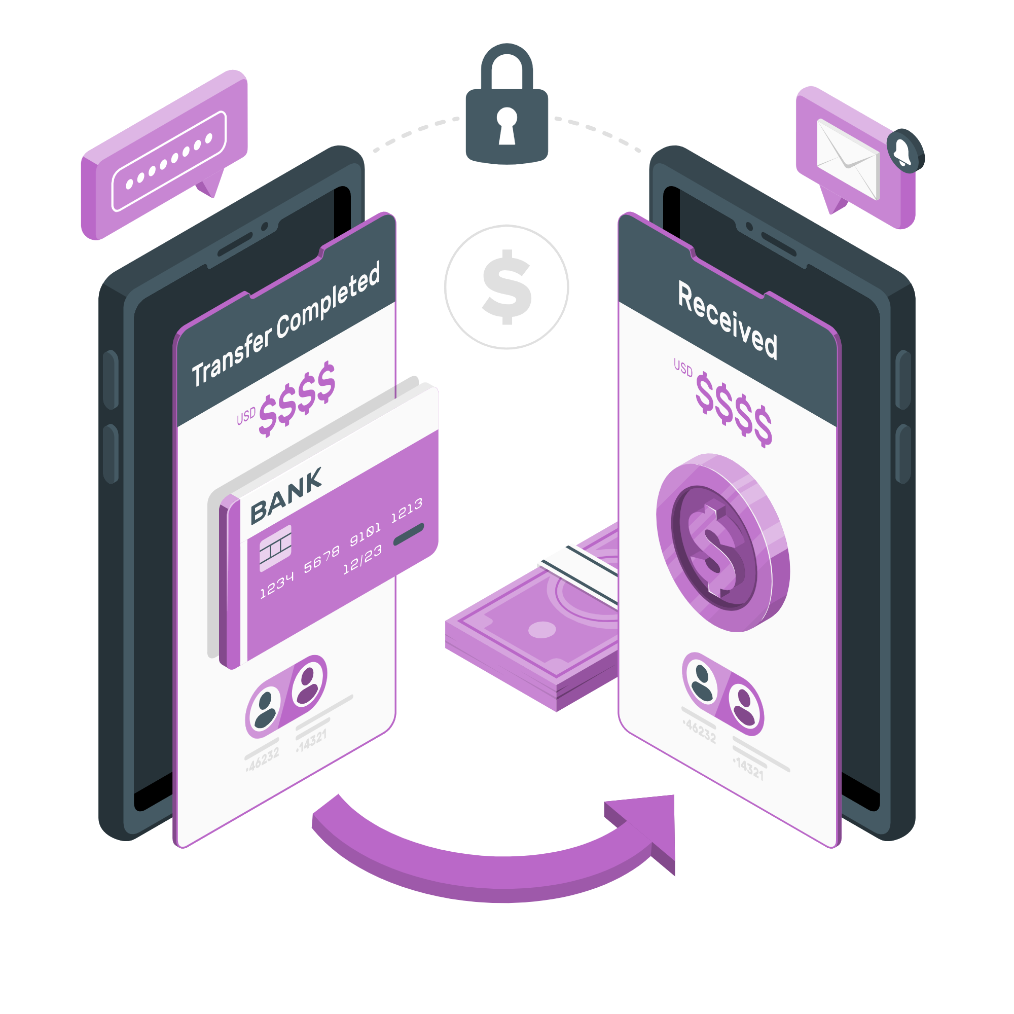



01
03
02
04
Sources of
Revenue
Transaction Fee / Commission model
Commercial Ads / Promotions
Subscription model
Royalty model

Slide 15
Expected Revenue Calculation
Commission Fees | 1.50% per transaction
Transaction per customer | 6 transaction per month
Advertising per month | 12000 ((2 ads*30 days)*Rs200)
Royalty fee | 30,000
Subscription | 200 per month
 | 580 half yearly
 | 1200 per year
On average Rs 660/-

Slide 16
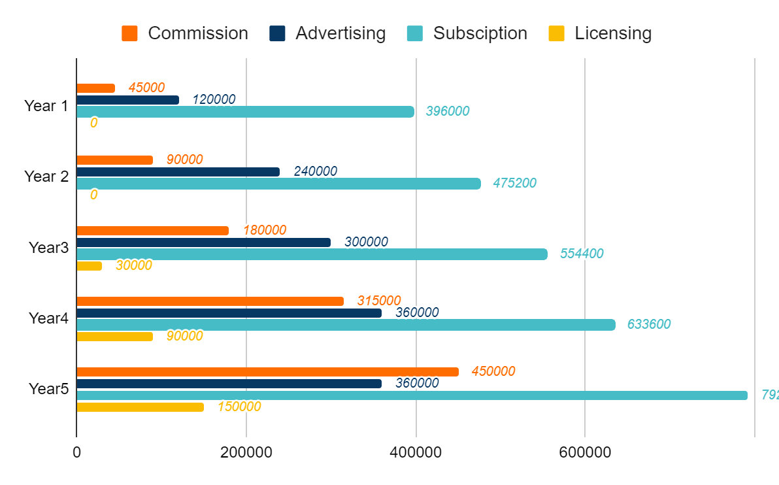
By
Year 5
Total Revenue
5,61,000
8,05,200
10,64,400
13,98,600
17,52,000
Year 1
Year 2
Year 3
Year 4
Year 5
792000

Slide 17
Expenses
01. Cash Burn / Initial Cost
02. Feature update
03. Customer service
04. Marketing Cost
01
Feb 2021- Aug 2021
02
Nov 2021
03
Aug 2021
04
Aug 2021

Slide 18


https://www.statista.com/statistics/1034443/india-upi-usage-by-platform/
https://blog.ipleaders.in/starting-e-wallet/amp/
https://www.spglobal.com/marketintelligence/en/documents/indiamobilepayments_2020finalreport.pdf
https://www.rsgmedia.com/rsg-rights-resources/royalty-and-licensing-basics/
Bibliography

Slide 19






DRISHTI CHULANI
JILL MORAKHIYA
jillmorakhiya07@gmail.com
drishti.chulani@gmail.com
RICHA RANE
SALONI BERA
myself.richa.rane@gmail.com
salonibera27@gmail.com
SANDOWEN RAMASAWMY
sandowen.r@gmail.com

